Slide 1
ARTIFICIAL INTELLIGENCE IN CYBER SECURITY
PRESENTED BY
GANGA PRAKASH.C
SOWMYA.S.S

Slide 2
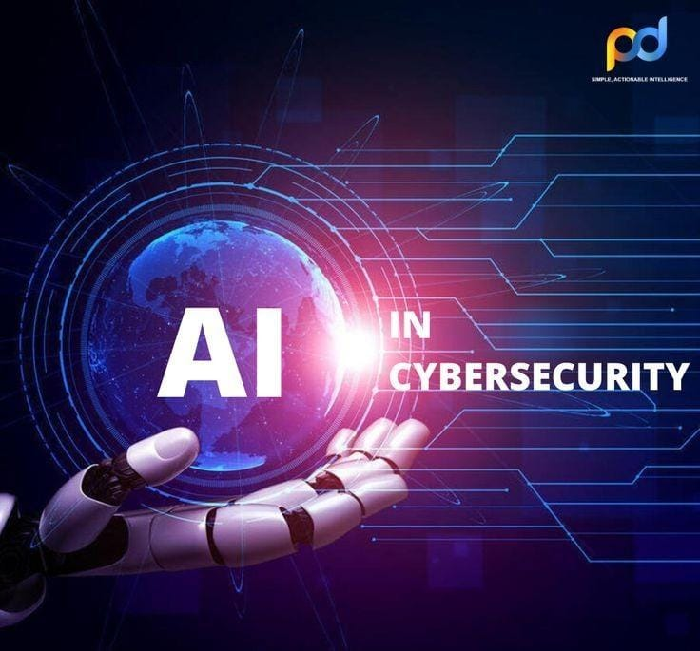
ARTIFICIAL INTELLIGENCE IN CYBER SECURITY

Slide 3
TABLE OF CONTENTS
Introduction to AI in Cyber security
Importance of AI in Cyber security
Key AI technology used in Cyber security
Application of AI in Cyber security
Case studies
Benefits of AI in Cyber security
AI in fraud detection and prevention
Challenges and limitations in Cyber
Future trends
conclusion

Slide 4
INTRODUCTION
Definition of AI:
Artificial Intelligence (AI) refers to the ability of machines and software to perform tasks that typically require human intelligence, such as learning, reasoning, and problem-solving. In cyber security, AI is used to enhance the detection, prevention, and response to cyber threats by analyzing vast amounts of data in real-time and identifying patterns of suspicious activity.
Relevance to Cyber security:
As cyber attacks become more sophisticated and frequent, traditional security methods struggle to keep pace. AI enables faster, more accurate threat detection, automates responses, and predicts potential attacks, making it crucial for defending against the ever-evolving landscape of cyber threats.
Need for AI:
The rise of advanced threats, such as ransom ware, phishing, and zero-day exploits, requires security systems that can adapt in real time. AI’s ability to analyze huge data sets, recognize anomalies, and respond immediately makes it essential for modern cyber security efforts.

Slide 5
IMPORTANCE OF AI IN CYBER SECURITY
Automates threat detection to catch attacks instantly.
Analyzes large data for hidden security patterns
Speeds up response times to minimize damage.
Predicts future attacks by learning from past incidents.
Reduces false positives for more accurate threat detection.
Adapts to new threats by evolving with cyber attacks.
Secures devices by spotting unusual behaviors.
Monitors in real-time for continuous risk assessment.
Detects phishing by analyzing suspicious emails.
Supports human experts by automating routine tasks.

Slide 6
KEY AI TECHNOLOGIES USED IN CYBER SECURITY
Machine Learning (ML): Learns from data to detect and predict threats.
Deep Learning: Identifies complex attack patterns with neural networks.
Natural Language Processing (NLP): Detects phishing emails and malicious text.
Anomaly Detection: Spots unusual behavior in networks and systems.
Behavioral Analytics: Tracks user activity to identify insider threats.
Automated Threat Intelligence: Gathers and analyzes global threat data.
Computer Vision: Detects malicious content in images or videos.
Predictive Analytics: Forecasts potential attacks based on historical data.
Reinforcement Learning: Improves response strategies through trial and error.
AI-powered Security Orchestration: Automates security operations and incident response.

Slide 7
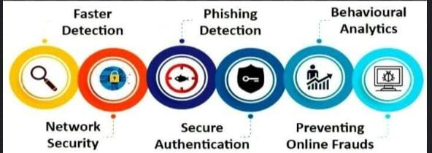
APPLICATION OF AI IN CYBER SECURITY
Detects malware and new types of attacks.
Filters phishing emails with advanced analysis.
Prevents fraud by monitoring transactions in real-time.
Automates incident response to handle attacks quickly.
Monitors networks for unusual activity or traffic.
Tracks user behavior to detect insider threats.
Finds vulnerabilities in software and systems.
Defends against DDoS and network intrusions.
Secures devices by spotting malicious actions.
Analyzes global threats for better protection.

Slide 8
CASE STUDY OF AI IN CYBER SECURITY
Overview:
Financial institutions face rising threats from fraud, including credit card fraud and identity theft. Traditional detection methods often fail to keep pace with sophisticated tactics used by fraudsters.
AI Implementation:
Banks utilize AI algorithms to analyze transaction patterns in real time. Machine learning models detect anomalies by learning individual customer behaviors.
Result:
Fraud Reduction: Institutions report up to a 50% decrease in fraud cases.
Enhanced Accuracy: Fewer false positives improve customer experience.
Cost Efficiency: AI-driven systems save millions in prevented fraud losses.
Example: Master card leverages AI to analyze transactions instantly, identifying suspicious activities and alerting customers proactively.

Slide 9
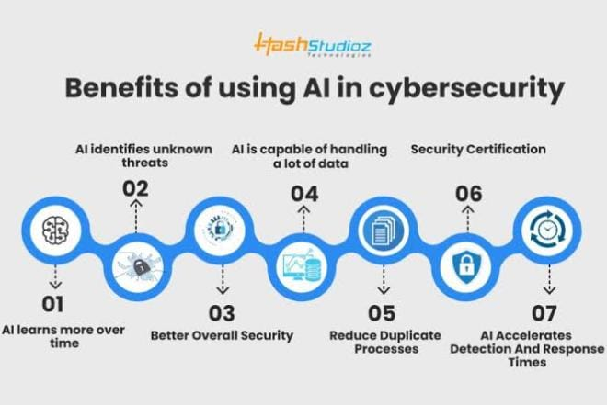
BENEFITS OF AI IN CYBER SECURITY
Faster threat detection
Reduced false positives
Automated incident response
Predicts future attacks
Real-time monitoring
Enhanced data analysis
Adaptive defense mechanisms
Improved endpoint protection
Identifies hidden vulnerabilities
Boosts human efficiency

Slide 10
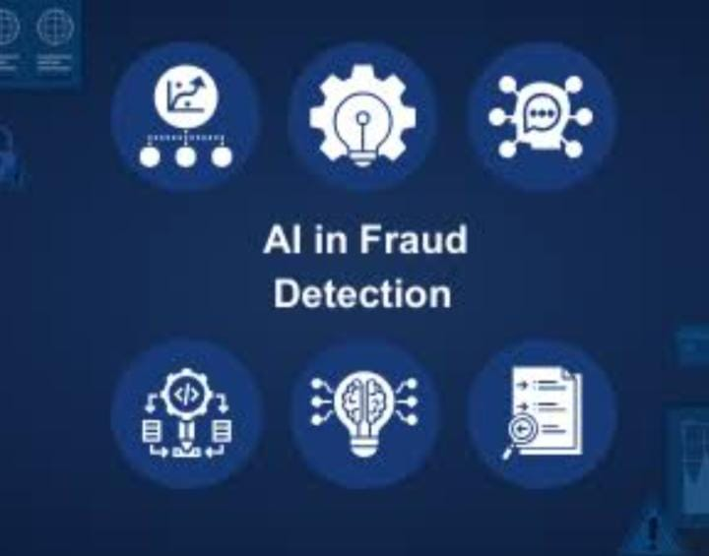
AI IN FRAUD DETECTION AND PREVENTION
Real-time Monitoring: AI analyzing transactions as they occur to detect fraud instantly.
Behavior Analysis: Machine learning models learn individual spending patterns
for accurate detection.
Anomaly Detection: AI identifies unusual activities that deviate from normal behavior.
Predictive Analytics: AI forecasts potential fraud by analyzing historical data trends.
Reduced False Positives: AI improves accuracy, minimizing legitimate transaction declines.
Automated Alerts: AI systems notify customers of suspicious transactions promptly.
Adaptive Learning: AI continuously updates its algorithms to adapt to new fraud tactics.
Cross-Channel Analysis: AI monitors multiple channels (e.g., online, in-store) for cohesive fraud detection.
Cost Savings: AI prevents fraud losses, saving financial institutions millions annually.
Enhanced Customer Trust: Proactive fraud detection builds customer confidence in security measures.

Slide 11
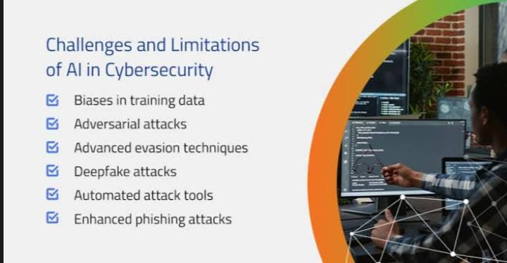
CHALLENGES AND LIMITATION OF AI IN CYBER SECURITY
High implementation costs
Dependence on data quality
False positives
Evasion by attackers
Bias in algorithms
Complexity in interpretation
Adversarial attacks
Limited adaptability

Slide 12
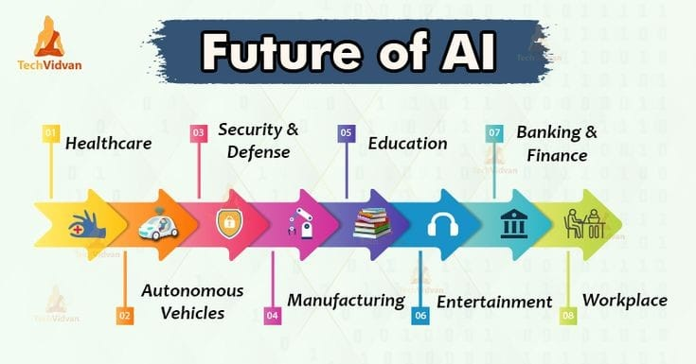
FUTURE TRENDS OF AI IN CYBER SECURITY
Autonomous threat response
AI-driven predictive security
AI-powered identity management
Improved AI for zero-day attack detection
Integration with block chain
AI in securing IOT devices
AI-enabled cloud security
Collaborative AI for global threat intelligence
AI-driven risk assessment
Use of AI to counter AI-driven cyber attacks

Slide 13
CONCLUSION
AI in Cyber security AI is transforming cyber security by enhancing threat detection, automating responses, and predicting future attacks with greater accuracy.
Its ability to process large volumes of data in real-time, identify anomalies, and adapt to evolving threats makes it indispensable in the fight against cybercrime.
While there are challenges, such as implementation costs and potential biases, the benefits far outweigh the limitations.
As cyber threats grow more sophisticated, AI will play an increasingly vital role in securing digital infrastructures, protecting organizations, and enhancing global cyber security efforts.

